Slide 1
Integrating UV protection into our WH&S practice: How to do it well with Cancer Council NSW support
Notes:
For the user:
This PowerPoint slide deck has been developed by Cancer Council NSW.
It is intended for workplace sun safety champions. Its purpose is to used as a support tool if presenting to senior management to gain their buy in and motivation to develop a sun safety action plan in the workplace with the support of Cancer Council NSW tools and resources.
Each slide is accompanied by suggested speaking points.
Please feel free to add or remove slides to suit your presentation. However, we request that where slides are used content is not changed.
Some slides supported by references. Full details of these references can be found at the end of the slide deck.
If you have any questions regarding this slide deck please contact Cancer Council NSW on sunsmart@nswcc.org.au or 02 9334 1761.

Slide 2
Presentation overview.
Sun protection – a ‘no brainer’ for Australia
Skin cancer in Australia
Who is at risk
What causes it
Workplace sun protection
The issue
Skin cancer claims
Best practice approaches
Cancer Council NSW is here to help
The Cancer Council NSW approach
Notes:
Today’s presentation will cover:
Sun protection – why it’s a ‘no brainer’ in Australia
Workplace sun protection
Cancer Council NSW is here to help, and their approach

Slide 3
Sun protection – a ‘no brainer’ for Australia .
Notes:
Sun protection: a ‘no brainer’ for Australia.
Let’s start by exploring the scale of the issue of skin cancer in Australia

Slide 4
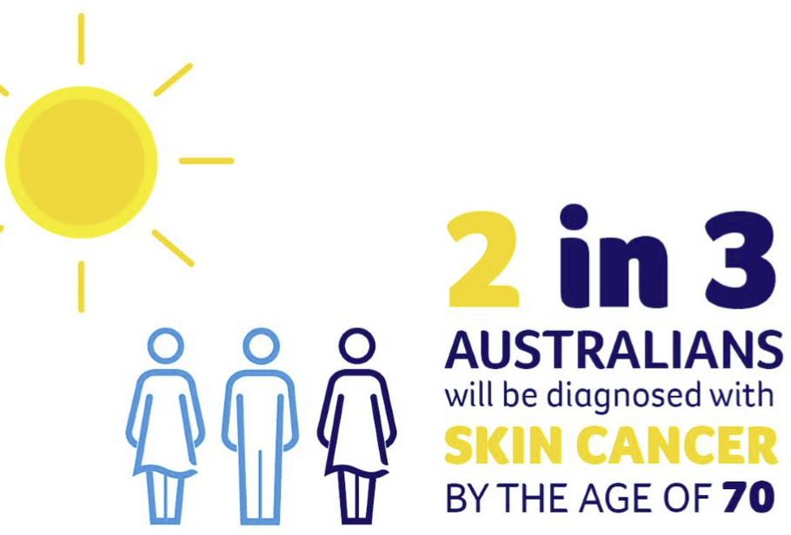
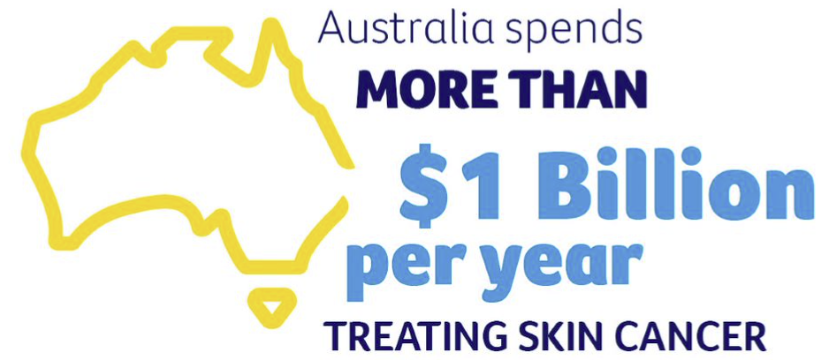
The scale of the issue
Notes:
Australia is the skin cancer capital of the world.
It is our most common cancer, with 2 in 3 Australians being diagnosed with some form of skin cancer by the age of 70.
It’s also our most costly cancer; we spend more than $1b per year treating skin cancer.

Slide 5
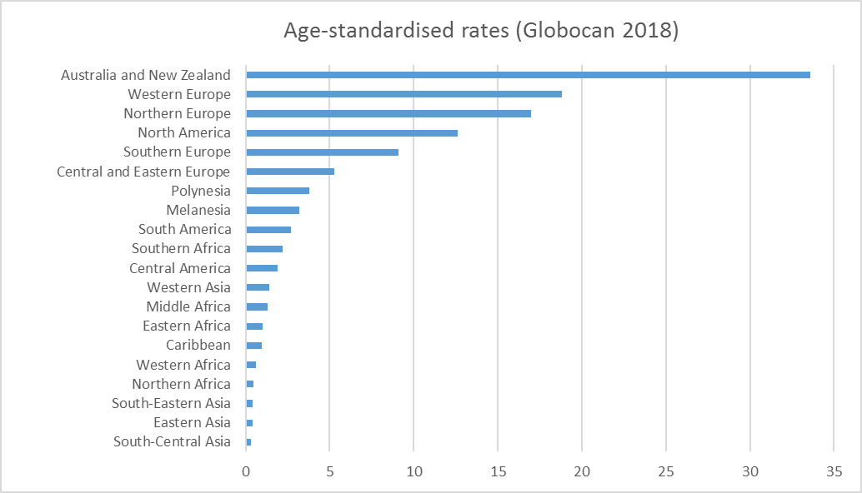
Australia has the highest rate of skin cancer in the world
MELANOMA INCIDENCE. Data source: Bray F, Ferlay J, Soerjomataram I, Siegel RL, Torre LA, Jemal A (2018). Global Cancer Statistics 2018: GLOBOCAN Estimates of Incidence and Mortality Worldwide for 36 Cancers in 185 Countries. CA Cancer J Clin. Full text available at: https://onlinelibrary.wiley.com/doi/full/10.3322/caac.21492
Notes:
This graph highlights that Australia and New Zealand lead the way for skin cancer globally.
The age standardised incidence rates for melanoma of the skin – show 34 people per 100,000 are diagnosed in our two countries.

Slide 6
Every 30 minutes someone is
diagnosed with melanoma.
One of us dies from melanoma every 5 hours.
A melanoma can grow quickly and become life threatening in just a few months.
Notes:
To emphasise the size of the problem in Australia,
Every 30 minutes someone is diagnosed with melanoma
One of us dies from melanoma every 5 hours
A melanoma can grow quickly and become life threatening in just a few months

Slide 7
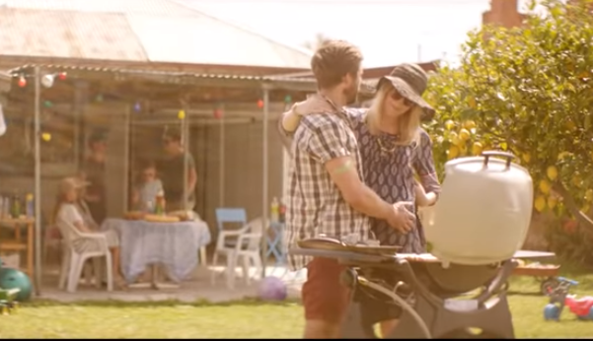
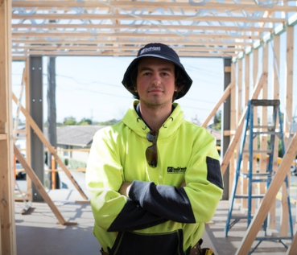
Who is at risk?
Everyone, but your risk is higher if you:
Work outdoors
Have fair skin that burns easily
Have many moles on your skin
Have a history of bad sunburn
Have had a skin cancer or family history of skin cancer
Spent a lot of time outdoors, unprotected
Have a suntan, used sunbeds in the past
Notes:
Everyone is at risk of developing skin cancer.
However, your risk is higher if you:
Work outdoors
Have fair skin that burns easily
Have many moles on your skin
Have a history of sunburn
Have had a skin cancer or family history of skin cancer
Spent a lot of time outdoors, unprotected
Have a suntan, or used sunbeds in the past

Slide 8
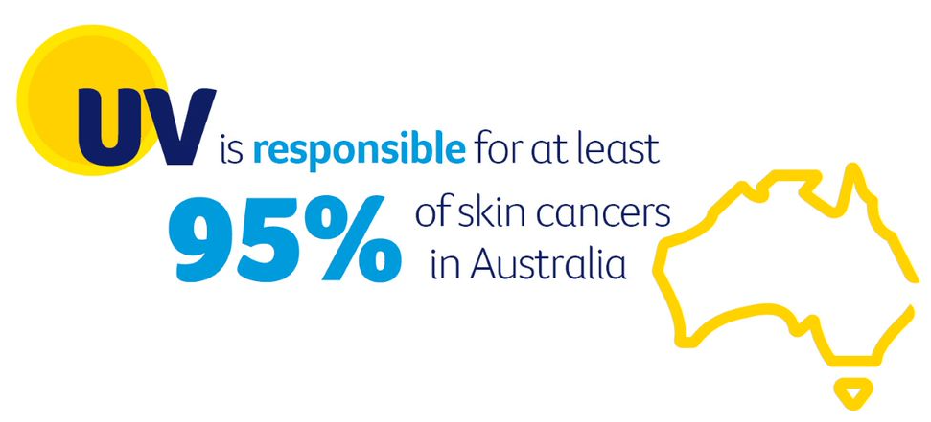
What causes it?
Protect your skin – reduce your risk
Notes:
What causes skin cancer?
Ultraviolet (UV) radiation from the sun is responsible for at least 95% of all skin cancers in Australia.
UV can damage our skin cells, which can multiply and form a skin cancer.
It’s important to remember that we can’t see or feel UV radiation. It isn’t related to temperature, and it isn’t related to heat.
It’s present everyday and even passes through cloud.
However, the good news is that when we protect our skin, we reduce our risk.

Slide 9
Workplace sun protection: work health and safety work health and safety . .
Notes:
This next section will focus on why sun protection is so important in the workplace

Slide 10
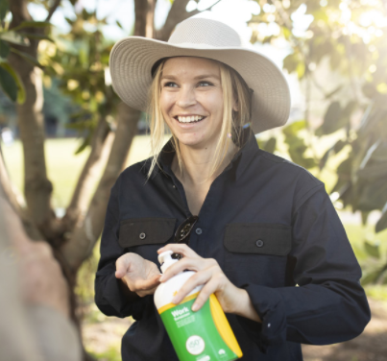
Outdoor workers: higher skin cancer risk.
UV exposure and outdoor workers
Receive 5-10 times more solar UV radiation exposure¹
UV radiation is a known carcinogen in the same category as asbestos and tobacco.
All organisations need to address the sun’s UV radiation and put UV safety control measures in place every day that will reduce exposure and prevent illness or injury
Treat it as a workplace hazard
It is required by law
Notes:
Outdoor workers are at high risk of developing skin cancer. They can receive between 5-10 times more exposure to UV radiation compared to indoor workers.
UV radiation is a known carcinogen in the same category as asbestos and tobacco.
All workplaces need to address the sun’s UV radiation and put UV safety control measures in place every day that will reduce exposure and prevent illness or injury.
UV radiation must be treated as a workplace hazard. It is required by law.

Slide 11
What are workplaces currently doing?
In Australia at work:
~50% of employees use protective clothing, sunscreen, hats or sunglasses²⁻⁵
However, no more than 10% are fully protected* while working outdoors^{2, 5}
Only 1/3 of employers are influencing workers to use sun protection, with employee self-initiative being the main prompt⁵
In NSW:
~25% of employers do not provide their employees with any sun protection⁴
There is an unmet need workplaces can do more
* i.e. use of all sun protection measures
Notes:
Cancer Council NSW has summarised some key insights from research investigating what Australian workplaces are currently doing when it comes to sun protection:
Approximately 50% of employees use protective clothing, sunscreen, hats or sunglasses when at work.
However, no more than 10% are fully protected (meaning they are using all 5 sun protection measures including protective clothing, sun safe hats, sunscreen, sunglasses and using shade).
Only 1/3 of employers are influencing their workers to use sun protection, with employee self-initiative being the main prompt.
In NSW, approximately 25% of employers do not provide their employees with any sun protection.
A key insight is that outdoor workers are more likely to rely on their employer than a doctor for sun protection information.
This highlights there is an unmet need and workplaces can do more.

Slide 12
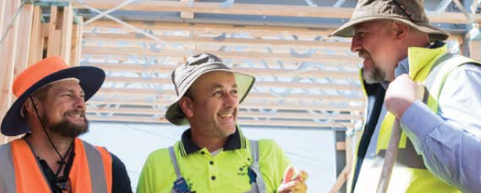
The legal case: compensation.
Nationally skin cancer claims represented ~17% of all occupational cancer claims between 2010/11-2018/19:
1,208 workers compensation claims for skin cancer accepted, costing $32.8m.⁶
In NSW between 2006/07 - 2016/17 claims cost more than $12.5M.⁷
Successful skin cancer compensation claims:
Show that the employer could have prevented the skin cancer injury from occurring had they implemented the necessary controls measures.⁸
Notes:
To add to that, legal case for skin cancer compensation is becoming increasingly recongised.
According to recent Safe Work Australia data from 2010/11-2018/19:
1,208 workers compensations claims for skin cancer were accepted, worth a total of $32.8m
This represents around 17% of all occupational cancer claims.
When we look at NSW alone: according to SafeWork NSW, in NSW between the period of 2006/07-2016/17, claims cost more than $12.5M.
Click
Where skin cancer compensation claims have been successful, they have shown that the employer could have prevented the skin cancer injury from occurring had they shown they had implemented the necessary control measures.

Slide 13
The case for workplace sun protection.
Tailored, multicomponent sun safety approaches achieve strongest results
Leadership buy in and workplace champions are critical facilitators of workplace change
Multicomponent programs can significantly increase worker’s perception of their workplace’s support for UV safety, resulting in their increased use of UV protection
When UV protection workplace policies are embedded into practice the risks are significantly reduced.⁹⁻¹³
Notes:
Cancer Council NSW has reviewed the evidence regarding effective UV safety programs in the workplace and consulted numerous stakeholders with experience in the workplace setting.
Key insights they have obtained that highlight the case for sun protection in the workplace include:
Tailored, multicomponent sun safety approaches achieve strongest results (multicomponent examples could include a workplace improving access to shade, providing workers with sunscreen in easily accessible places, mandating sun-safe hats and communicating sun safety throughout the workplace).
Leadership buy in and workplace champions are critical facilitators of workplace change.
Multicomponent programs can significantly increase worker’s perception of their workplace’s support for UV safety, resulting in their increased use of UV protection.
When UV protection workplace policies are embedded into practice, the risks are significantly reduced.

Slide 14
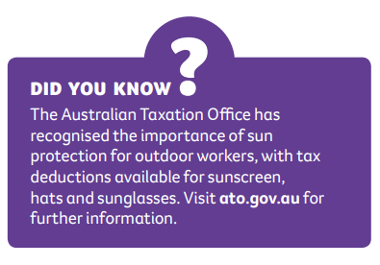
The case for workplace sun protection
Notes:
Lastly, to add to the case for sun protection in workplaces, the Government recognises the importance of sun protection for outdoor workers.
As such, tax deductions are available on sun protection products such as sunscreen, hats and sunglasses via the Australian taxation office.

Slide 15
Our workplace current state of play
This slide has been left blank.
You may like to add a summary of sun safety controls your workplace is implementing, any known history of claims, and where you feel your workplace could improve.
Delete this slide if not applicable.
Notes:
This slide has been left blank.
You may like to add a summary of sun safety controls your workplace is implementing, and where you feel your workplace could improve.
Delete this slide if not applicable.

Slide 16
Cancer Council NSW is here to help .
Notes:
Drawing on these insights, Cancer Council NSW is offering complimentary support to bring about effective change in our workplace sun safety culture.

Slide 17
Cancer Council NSW approach
Notes:
They have developed an approach that aims to increase workplace engagement in the importance of sun protection for outdoor workers, through a tailored and comprehensive approach.

Slide 18
CCNSW approach: keeping it simple
Workplaces are supported to:
Prioritise areas for improvement
Developed a tailored action plan aligned with the WH&S hierarchy of risk control
Implement, monitor and review their plan
Assess risk of UV exposure and current sun safety practices
Flexible to suit workplace needs, WH&S processes and timelines
Notes:
The approach is kept simple and workplaces like ours are supported to:
Assess their risk of UV exposure in the workplace, and current sun safety practices.
Prioritise areas for improvement, develop a tailored action plan with practical strategies that align with the WH&S hierarchy of controls.
Implement, monitor and review their plan.
The approach is flexible to fit in with our workplace needs, WH&S processes and timeline.

Slide 19
How does it work in practice?
Phases | What CCNSW will do | What your workplace can do
Plan | Support your WH&S contact in gaining senior leader buy-in on the importance of workplace sun safety. | Engage senior leaders in sun safety. Nominate your WH&S champion/s. Form a small working group to enable broad workplace representation.
 | Support your nominated champion in assessing current practice, strengths and areas for focus in a new action plan. | Reflect on sun safety in your workplace. Complete a UV Risk Assessment and develop an Action Plan. Consult with a cross section of workers. Confirm Action Plan priorities and time frames with senior leaders and key staff.
Notes:
The tables in these next two slides provide a topline summary of what the approach will look like in practice, detailing:
The three main phases - Plan, Do, Review
What Cancer Council NSW will do to support us
What our workplace can do
Speaker can talk to all or some of the points in the tables

Slide 20
How does it work in practice?
Phases | What CCNSW will do | What your workplace can do
Do | Tailor the support we provide to suit the needs of the champion/committee e.g. staff presentations. Workshop strategies to enhance ‘enablers’ and reduce ‘barriers’. | Launch program. Lead program implementation and consider various change management engagement strategies. Share progress and feedback with CCNSW.
Review | Engage champion periodically for progress check-ins to acknowledge achievements, challenges and next steps. | Keep a record of actions implemented and their results Seek feedback from staff and keep working groups informed of progress.
Notes:
Speaker can talk to all or some of the points in the table.

Slide 21
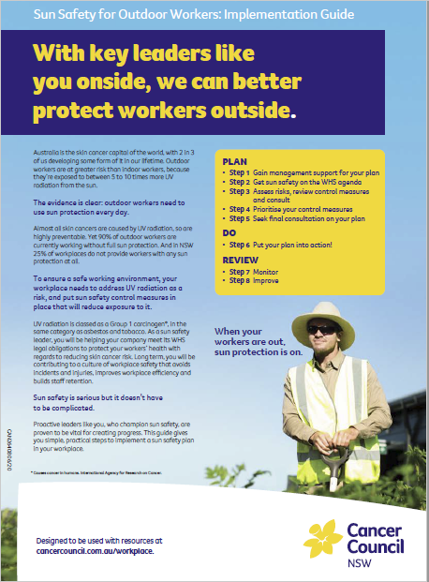
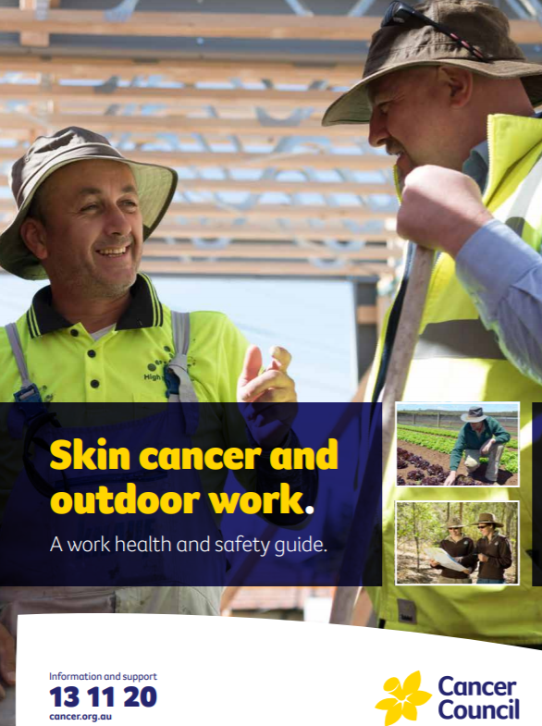
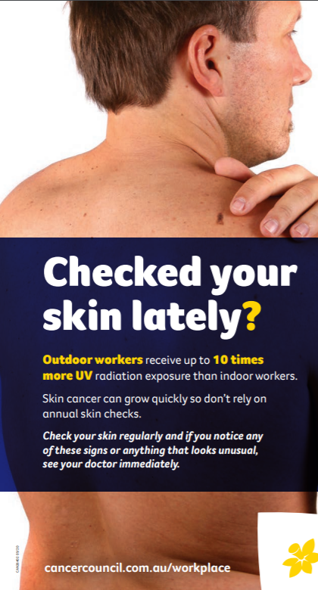
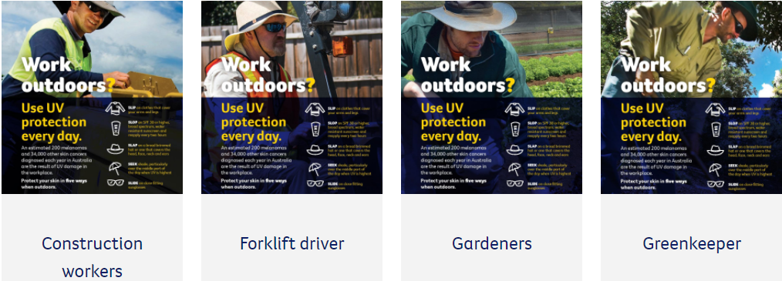
Resources.
Comprehensive 32-page WH&S guide
Champion’s Guide
Ppt to gain management buy-in
UV risk control guide: Baseline assessment Action plan
Sample UV Safety Policy
UV safety posters, fact sheets
SafeWork/CCNSW UV Safety Webinar
Case studies
More in development
Notes:
A number of resources are available to support our workplace implement a sun safety plan including a:
Practical Champion’s Implementation Guide
UV Risk Assessment and Action Plan
Sample Policy
Posters, factsheets
More will be developed as Cancer Council NSW learns more about workplaces’ needs.

Slide 22
With key leaders like you onside, we can better protect our workers outside.
Thank you.
Notes:
With your support and motivation to take action, we can better protect our workers by implementing practical actions developed by Cancer Council NSW to improve our sun safety culture.

Slide 23
References.
Gies P, Wright J. Measured solar ultraviolet radiation exposures of outdoor workers in Queensland in the building and construction industry. Photochemistry and Photobiology. 2003;78(4):342-8.
Carey RN, Glass DC, Peters S, Reid A, Benke G, Driscoll TR, et al. Occupational exposure to solar radiation in Australia: who is exposed and what protection do they use? Australian and New Zealand Journal of Public Health. 2014;38(1):54-9.
SafeWork Australia. National hazard exposure worker surveillance (NHEWS) survey: 2008 results. Canberra: Safe Work Australia; 2009. 279 p. Available from: https://www.safeworkaustralia.gov.au/system/files/documents/1702/nationalhazardexposureworkersurveillancenhewssurveyresults_2008_pdf.pdf.
Social Research Centre. 2019 Cancer prevention community survey. Melbourne: The Social Research Centre; 2019. 117 p.
Cancer Institute NSW. Sun protection attitudes, intentions and behaviours of NSW males aged 40–65 years. Sydney: Cancer Institute NSW; 2019. 47 p. Available from: https://www.cancer.nsw.gov.au/getattachment/how-we-help/reports-and-publications/sun-protection-attitudes-intentions-and-behaviour/Sun-Protection-Behaviours-with-Men-Aged-40-65-Years-presentation.PDF?lang=en-AU.
Safe Work Australia. National Data Set for Compensation-based Statistics (NDS). Canberra Australia; 2022Safe Work Australia. Workplace compensation data. Canberra, Australia: National Data Team, Safe Work Australia; 2014. Safe Work Australia. Workplace compensation data. Canberra, Australia: National Data Team, Safe Work Australia; 2014.

Slide 24
References.
SafeWork NSW. Ultra-violet radiation [Internet]. [Place unknown]: SafeWork NSW; [Date unknown] [cited 2020 Jul 06]. Available from: https://www.safework.nsw.gov.au/hazards-a-z/working-in-extreme-heat/content-page-blocks/ultra-violet-radiation-uvr.
Cancer Council Western Australia. Workers’ compensation claims paid in Australia 2000-2009. Perth: Cancer Council Western Australia; 2011. 21 p. Available from: https://www.cancerwa.asn.au/resources/2011-12-05-ccupational-exposure-to-ultraviolet-radiation.pdf.
Makin J, Shaw K, Winzenberg T. Evidence check – targeted programs for skin cancer prevention: an evidence check rapid review brokered by the Sax Institute (www.saxinstitute.org.au) for the Cancer Institute NSW. Sydney; 2018. 381 p.
Queensland University of Technology. QUT outdoor worker sun protection project. Herston: Queensland University of Technology; 2013. 659 p.
Andersen PA, Buller DB, Walkosz BJ, Scott MD, Kane IL, Cutter GR, et al. Expanding occupational sun safety to an outdoor recreation industry: a translational study of the Go Sun Smart program. Translational Behavioral Medicine. 2012;2(1):10-8.
Buller DB, Walkosz BJ, Buller MK, Wallis A, Andersen PA, Scott MD, et al. Results of a Randomized Trial on an Intervention Promoting Adoption of Occupational Sun Protection Policies. American Journal of Health Promotion. 2018;32(4):1042-53.
Haynes E, Kramer DM, Strahlendorf P, Holnessc DL, Kushnera R, Tenkate T. A cross-Canada knowledge transfer and exchange workplace intervention targeting the adoption of sun safety programs and practices: sun safety at work Canada. Safety Science. 2018;102:238-50.

