Slide 1
INSTRUCTIONAL SLIDE – delete after reading
This PowerPoint slide deck has been developed by Cancer Council NSW.
It is intended for workplace sun safety champions who are wanting to educate and inform staff and volunteers about the importance of sun safety.
This presentation is designed to be engaging and provide staff with opportunities to discuss and provide input into your sun safe workplace program.
It can be used as part of WHS training and education activities in your workplace.
Each slide is accompanied by suggested speaking points or instructions about where to go for more information.
Italicised blue text on slides are instructions and can be removed once read.
Please feel free to add or remove slides to suit your presentation. Some slides are supported by references. Full details of these references can be found at the end of the slide deck.
If you have any questions regarding this slide deck please contact Cancer Council NSW on sunsmart@nswcc.org.au or 02 9334 1761.
Notes:
For more information, tools and resources, visit www.cancercouncil.com.au/sunsmart-workplaces

Slide 2
SunSmart Workplaces
Presentation to workers
Notes:
For the user:
This PowerPoint slide deck has been developed by Cancer Council NSW.
It is intended for workplace sun safety champions. Its purpose is to used as a support tool if presenting to senior management to gain their buy in and motivation to develop a sun safety action plan in the workplace with the support of Cancer Council NSW tools and resources.
Each slide is accompanied by suggested speaking points.
Italicised blue text on slides are instructions and can be removed once read.
Please feel free to add or remove slides to suit your presentation. However, we request that where slides are used content is not changed.
Some slides supported by references. Full details of these references can be found at the end of the slide deck.
If you have any questions regarding this slide deck please contact Cancer Council NSW on sunsmart@nswcc.org.au or 02 9334 1761.

Slide 3
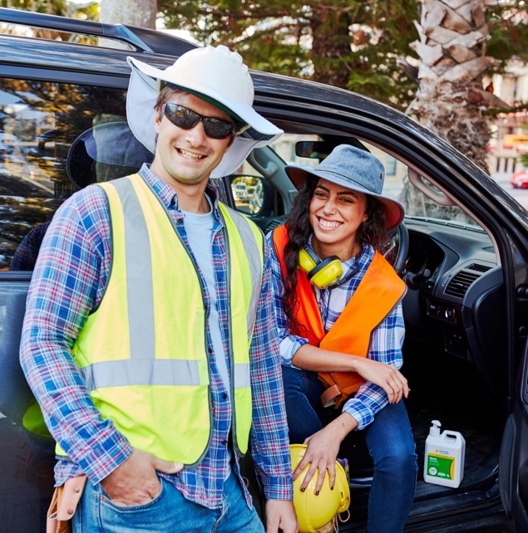
Presentation overview.
Why sun safety at work matters
How to stay safe at work
How we can work together
Notes:
Today’s presentation will cover:
Why sun safety at work matters
How to stay sun safe at work
How we can work together

Slide 4
Why sun safety at work matters.
Notes:
Let’s start by exploring the scale of the issue of skin cancer in Australia and how this serious health risk applies to our workplace.

Slide 5
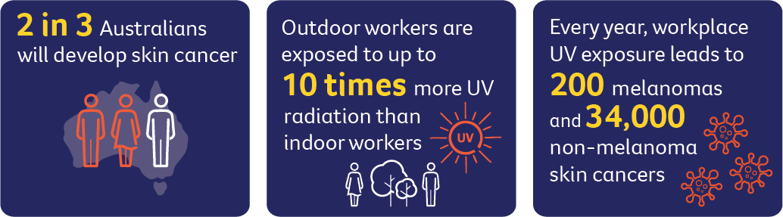
The issue we can’t ignore.
Notes:
Australia is the skin cancer capital of the world.
It is our most common cancer, with 2 in 3 Australians being diagnosed with some form of skin cancer.
Every year, workplace UV exposure leads to 200 melanomas and 34,000 non-melanoma skin cancers.

Slide 6
Myth-busting.
Myth | Fact
If it’s not hot, the UV isn’t high. | UV radiation from the sun has nothing to do with temperature. You can be exposed to high UV on cool, cloudy or windy days.
I don’t burn, so I don’t need protection. | Tanning and skin darkening are signs of damage. All skin types can be harmed by UV exposure.
Skin cancer only affects older people. | UV damage from the sun builds up over time. Outdoor workers are at high risk from a younger age.
Protective clothing is too hot to wear safely. | Lightweight, breathable UPF-rated clothing can keep you cooler while protecting your skin.
Sun safety is a personal choice. | UV exposure is a workplace hazard. Employers and workers share responsibility for managing it safely.
Notes:
Instruction: read through each myth and fact.

Slide 7
Why does sun safety at work matter to you?
This slide provides an opportunity to discuss and engage with workers on the topic.
Notes:
Instruction: this is an opportunity to engage with workers on the topic and start a discussion about risk. Encourage workers to think about how it personally affects them.

Slide 8
How to stay sun safe at work.

Slide 9
The good news is that skin cancer is one of the most preventable cancers.
It's never too late to start taking sun protection seriously
If we take action now we can:
reduce our risk of skin cancer, eye damage and premature ageing
set a positive example for younger staff
look after our mates
be part of a positive work culture
return home safely to our family and friends.
Notes:
While the risk of skin cancer is very serious, the good news is that is the most preventable type of cancer. But there area also other benefits for you and your workplace is you take preventative measures now.

Slide 10
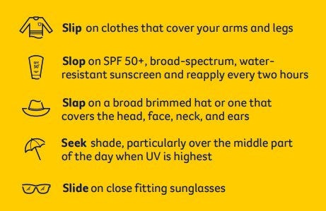
What you can do to protect yourself.
Understand your risk and responsibilities [link to workplace policy].
Know the controls your workplace has in place and help to implement these every day [link to workplace action plan]
Check on your mates and your team to make sure everyone benefits from sun safe measures.
Share your ideas about how our workplace can be more sun safe.
Notes:
Instruction: consider updating talking points with more specific content for your workplace (e.g. uniform requirements for PPE)
Clothing is your first line of defence. Wear long sleeves, long pants and a broad-brim hat or neck flap.
Apply sunscreen throughout the day, not once.
Use natural shade, vehicle cabins or temporary shelters where you can, when the UV is highest.
It’s also important to know your skin and see your doctor if you notice a change.

Slide 11
How your actions make a difference.
When people see others doing the right thing they are more likely to do it too.
Even when we are doing our best, sometimes we forget something – let’s have each others' backs.
We can create a positive workplace culture where safety is a priority.
This workplace has a responsibility to ensure you can work in a safe environment, but you are on the ground so it is your responsibility to speak up when something could be improved.
Notes:
Taking responsibility for your own health benefits others. A sun safe workplace is a team effort.
When people see others doing the right thing they are more likely to do it too.
Even when we are doing our best, sometimes we forget something – let’s have each others' backs.
We can create a positive workplace culture where safety is a priority.
This workplace has a responsibility for ensuring you can work in a safe environment, but you are on the ground so it is your responsibility to speak up when something could be improved.

Slide 12
Let’s improve our sun safe workplace program.
Notes:
Instruction: this section is optional and is designed to engage with workers on an idea or initiative to improve your sun safe workplace program. This ensures worker buy-in and is more likely to result in ongoing commitment. This part of the presentation can be run as a workshop in person or online.

Slide 13
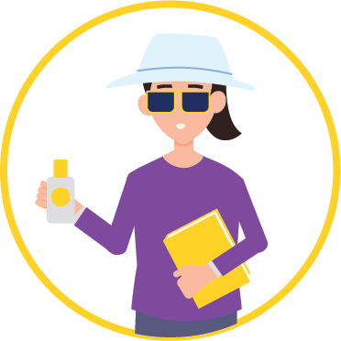
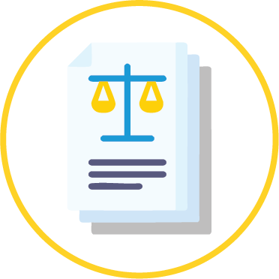



Effective sun safe programs.
An effective sun safe program at work needs to include these five things:
Leadership
Sun safety policy
Practical actions for both employers and employees
Education and training
Ongoing commitment
Notes:
There are five key elements that will support an effective sun safe workplace. Our workplace should be taking action in all of these areas.
Leadership
Leadership buy-in is essential because commitment from decision-makers sets the tone for a safe workplace culture and ensures sun safety is treated as a genuine organisational priority, not an optional extra.
When leaders champion UV protection, workers are more likely to engage in safe behaviours, and meaningful, lasting change becomes possible.
Policy
A sun safety policy clearly sets out expectations and responsibilities for employers and individuals.
Action for employers and employees
Policies needs to be supported by meaningful action. An action plan will be critical for implementation of sun safe protections. Workplaces may want to consider scheduling, shade infrastructure and the provision of appropriate PPE, while workers should take responsibility for applying sunscreen, wearing protective clothing and seeking shade where possible.
Education and training
We need to ensure our workers are aware of the risks and understand what they can do to avoid or limit UV exposure.
Ongoing commitment and consultation
Our action plan should be regularly reviewed to ensure measures are effective and stay on the agenda. Feedback from workers should also be included in development of the action plan and any review processes, to support continuous improvement and genuine change.
References
Cancer Council Victoria. (2025). Skin cancer and outdoor work: A work health and safety guide (Updated April 2025). National Skin Committee; SunSmart. https://www.sunsmart.com.au/downloads/resources/booklets/skin-cancer-outdoor-work-employer-booklet.pdf

Slide 14
Current state of play.
This slide has been left blank so you can tailor content.
You may like to add a summary of sun safety controls your workplace is implementing.
See notes on this slide for more ideas.
Notes:
You may like to add a summary of sun safety controls your workplace is implementing, and what can be built upon.
Consider taking the online workplace assessment to better understand your current state of play.
Relevant resources
Workplace assessment tool www.cancercouncil.com.au/sun-safe-workplace
Hierarchy of controls www.cancercouncil.com.au/sun-safe-workplace

Slide 15
Gaps and opportunities.
Do you see any gaps or opportunities to improve sun safety in our workplace?
Leadership | Discussion about how leadership can make a difference
SunSmart policy | Discussion about policy
Practical actions for both employers and employees | Discussion about actions
Education and training | Discussion about education and training
Ongoing commitment and consultation | Discussion about how staff and workplaces can ensure an ongoing commitment to sun
Notes:
Instruction: this is an opportunity for staff and workplaces to brainstorm ideas and opportunities for improvement. We encourage you to take some notes while discussion is happening and consider how these ideas can be built into policy and action plans.
Relevant resources
Workplace assessment tool www.cancercouncil.com.au/sun-safe-workplace
Hierarchy of controls www.cancercouncil.com.au/sun-safe-workplace

Slide 16
Developing an idea that works.
1. Define the problem What are we trying to solve? Who does it impact?
2. Empathise Spend 2-3 mins thinking about the people who we want to help. What would this initiative look like in practice? List what is going to make this easier for them to do, and what will make it harder to do.
3. Optimise What things will make the biggest difference when implementing this initiative in our workplace?
4. Steps to implement What needs to happen to do this? (Consider resourcing, staff commitment, training, equipment).
Notes:
Instruction: this is collaborative activity for staff to work together on a particular idea or initiative. If presenting in person, consider proving paper and pens for staff so that they can write down activities or alternatively, discuss as a group with a notetaker.

Slide 17
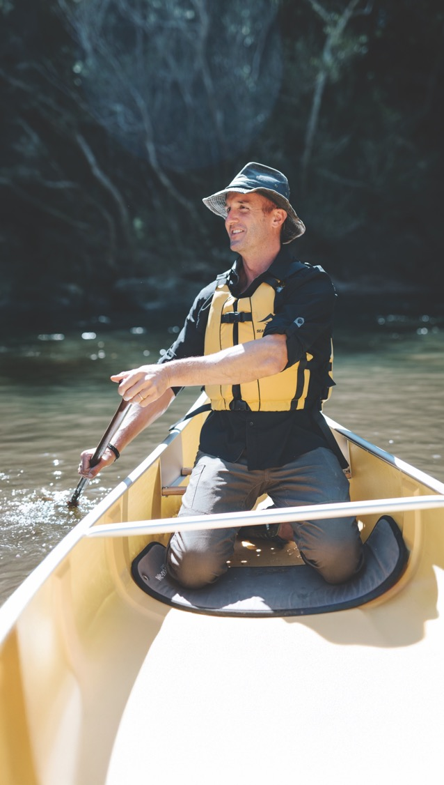
Next steps.
Insert any required next steps to implement a change or make an improvement in your workplace. You may have a feedback mechanism which you would like to share with staff.

Slide 18

Education and training.
Insert any relevant education and training resources for outdoor workers.
Visit www.cancercouncil.com.au/sunsmart-workplaces
for videos, posters, and training on sun safety at work.
Notes:
Instruction: Visit www.cancercouncil.com.au/sunsmart-workplaces and find education and training resources for workers.

Slide 19
More information www.cancercouncil.com.au/sunsmart-workplaces
Notes:
www.cancercouncil.com.au/sunsmart-workplaces

